Slide 1

JAVA SWING
Submitted by : Tejaswi Sen
Course : BCA
Batch : 2025
Date : 24-Sep-2025

Slide 2
Introduction
Swing is a part of Java Foundation Classes (JFC) and is a lightweight GUI toolkit provided by Java to create graphical user interfaces (GUIs) for desktop applications. It allows developers to build rich, interactive, and platform-independent interfaces that can include windows, panels, buttons, text fields, labels, images, tables, trees, menus, and many other components.
Swing is built on top of AWT (Abstract Window Toolkit) but is more flexible because it provides “lightweight” components, which means they do not rely entirely on the native operating system’s GUI resources. This makes Swing applications more portable across different operating systems.
Swing supports:
We developed a desktop login page project based on Java Swing, focusing on building a Graphical User Interface (GUI) for a college management system. The project utilizes multiple object-oriented concepts and incorporates several header files and classes to structure the code efficiently.

Slide 3
Summary:
JFrame: Main window
JPanel: Sections (Left image, Right login form)
JLabel: Displays text and images
JTextField / JPasswordField: User input
JButton: Performs login action
Layouts: Arranges components neatly
Colors & Borders: Makes GUI attractive and organized
ActionListener: Handles button click events

Slide 4
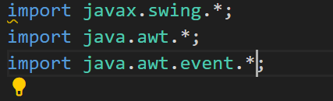
Header files
javax.swing.*
Provides all the core Swing GUI components.
Used for creating windows, panels, buttons, labels,
text fields, tables, and other interface elements.
java.awt.*
Provides layout managers, colors, fonts, and graphics utilities.
Used to arrange components, set colors, fonts, sizes, and make the GUI
look neat and attractive.
java.awt.event.*
Provides event-handling classes.
Used to detect and respond to user actions like button clicks, mouse
movements, or keyboard input.

Slide 5
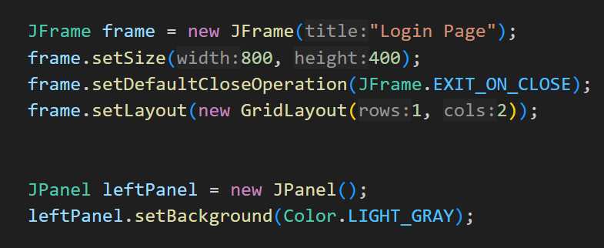
Swing Components Used in Login Page
JFrame
Kya hai: JFrame ek main window hoti hai jisme hum GUI ka sara content rakhte hain.
Use in Login Page: Login page ka pura interface isi window mein show hota hai. Hum isme left panel (image) aur right panel (login form) add karte hain.
JPanel
Kya hai: JPanel ek container hai jisme hum components ko group kar sakte hain.
Use in Login Page: Left panel me logo image, right panel me username/password fields aur login button rakhe gaye hain. Isse GUI organized aur neat dikhta hai.

Slide 6
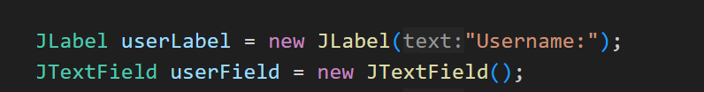
JLabel
What it is: JLabel is used to display text or images.
Use in Login Page: Used for labels like “Username” and “Password” and for displaying the logo image on the left panel.
JTextField
What it is: A single-line text input field.
Use in Login Page: Allows the user to enter the username.

Slide 7
JPasswordField
What it is: A special text field that hides input characters.
Use in Login Page: Allows the user to securely enter the password
JButton
What it is: A clickable button.
Use in Login Page: When the login button is clicked, it triggers username/password validation

Slide 8
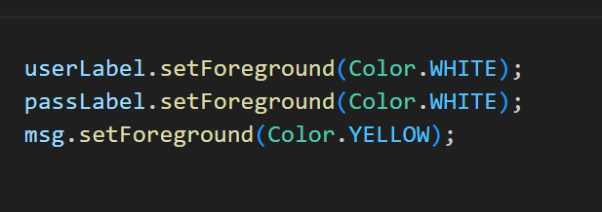
Layouts (GridLayout, BorderLayout)
What it is: Layout managers control the arrangement of components.
Use in Login Page:
Right panel: GridLayout with 4 rows and 2 columns organizes username/password fields, button, and messages neatly
JFrame: GridLayout (1 row, 2 columns) is used to place the left and right panels side by side.
setBackground / setForeground
What it is: Sets colors for panels and text.
Use in Login Page: The right panel has a blue background, and text is white/yellow to make the GUI readable and attractive.

Slide 9
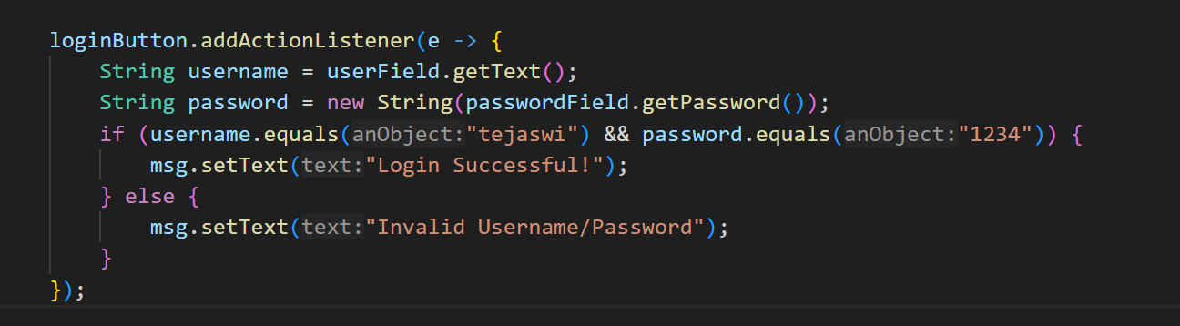
Borders (setBorder)
What it is: Adds padding around components.
Use in Login Page: Provides spacing between the edges of the panel and the components, making the interface look clean and professional
ActionListener
What it is: Handles user actions, such as button clicks.
Use in Login Page: When the login button is clicked, it validates the username and password and displays a success or error message.

Slide 10
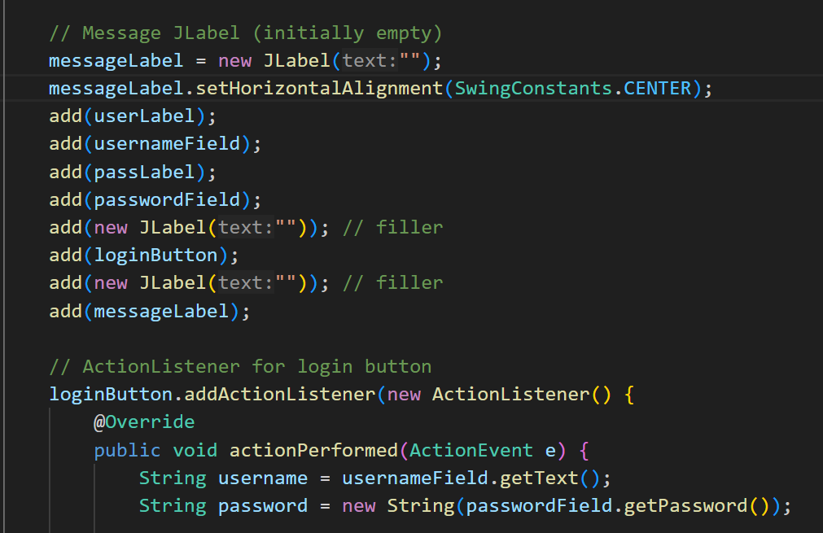
ActionListener
What it is: Handles user actions, such as button clicks.
Use in Login Page: When the login button is clicked, it validates the username and password and displays a success or error message
Message JLabel
What it is: An initially empty label that displays messages later.
Use in Login Page: Displays “Login Successful” or “Invalid Username/Password” messages.

Slide 11
Login Page Design & Layout
Overall Structure (JFrame)
The main window (JFrame) is divided into two sections
using GridLayout with 1 row and 2 columns.
Left Section: Image panel (logo or illustration).
Right Section: Login form with fields and button.
Left Panel (JPanel + JLabel)
Contains a logo image using ImageIcon inside a JLabel.
Background color: Light Gray.
Purpose: Provides a visual identity and makes the interface appealing.

Slide 12
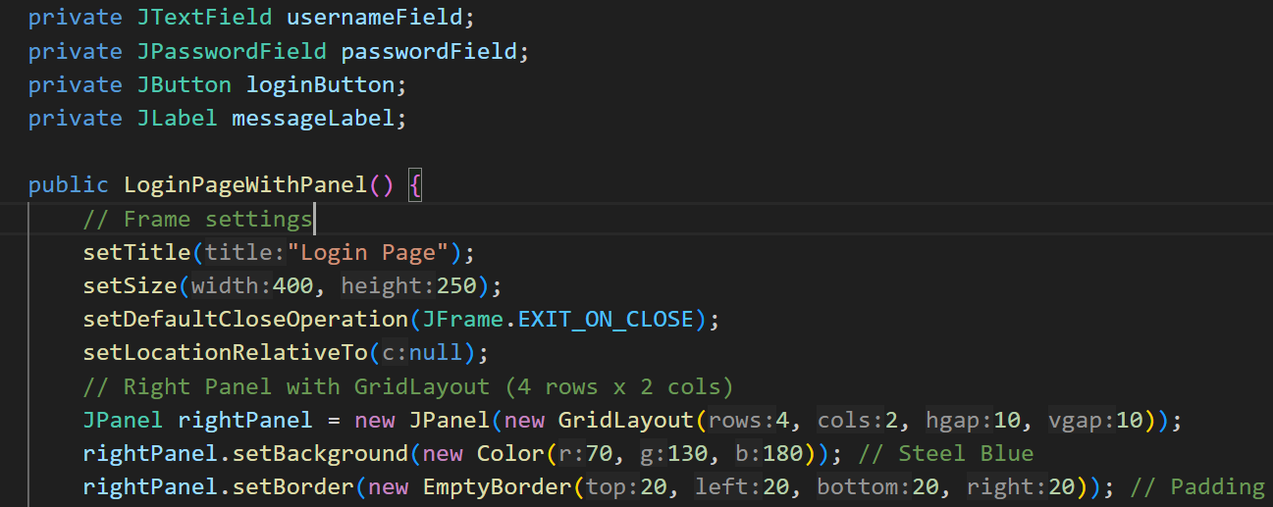
Right Panel (JPanel + GridLayout)
Contains the login form arranged in 4 rows x 2 columns:
Username label + text field
Password label + password field
Empty cell + Login button
Empty cell + Message label
Background color: Steel Blue (or custom color).
Padding: Added using setBorder to keep components away from edges.
Components in Right Panel
JLabel: “Username”, “Password”, and message label.
JTextField & JPasswordField: User input fields.
JButton: Login button.
Colors: Labels white, message yellow, background blue.

Slide 13
User Interaction
When the Login button is clicked, ActionListener validates the
credentials.
Message JLabel shows “Login Successful” or “Invalid Username
/Password”.
Visual Flow
Left panel draws attention to the logo.
Right panel clearly guides the user to enter credentials and login.
Layout ensures balanced spacing, neat alignment, and professional
appearance.

Slide 14
Conclusion
We successfully developed a Login Page using Java Swing with
a clean and professional GUI.
The project demonstrates the use of Swing components like
JFrame,
JPanel, JLabel, JTextField, JPasswordField, and JButton.
Event handling using ActionListener makes the interface interactive.
The login page provides secure and user-friendly access to the
system.
Layouts, colors, and borders ensure a visually appealing design.

Slide 15
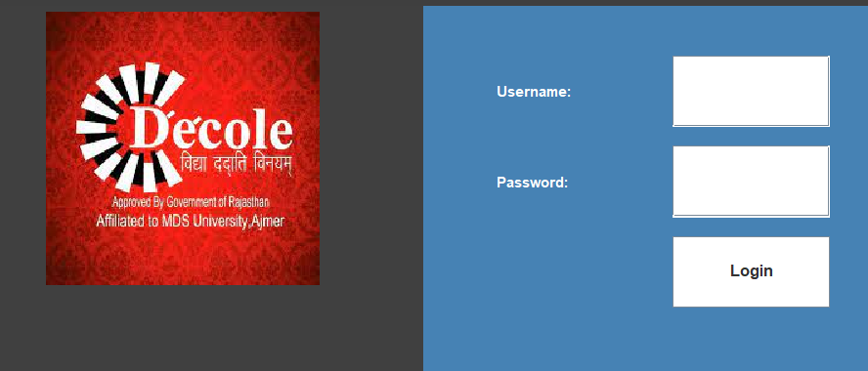
Username = Tejaswi
Password = 1234

Slide 16
Future Scope
Integrate with a database to allow multiple users and
real-time credential
validation.
Extend the login page into a full College Management System
with modules
for students, staff, attendance, and exams.
Add role-based login (Admin, Staff, Student) for better access
control.
Enhance GUI with animations, themes, and more interactive
features.

